Slide 1
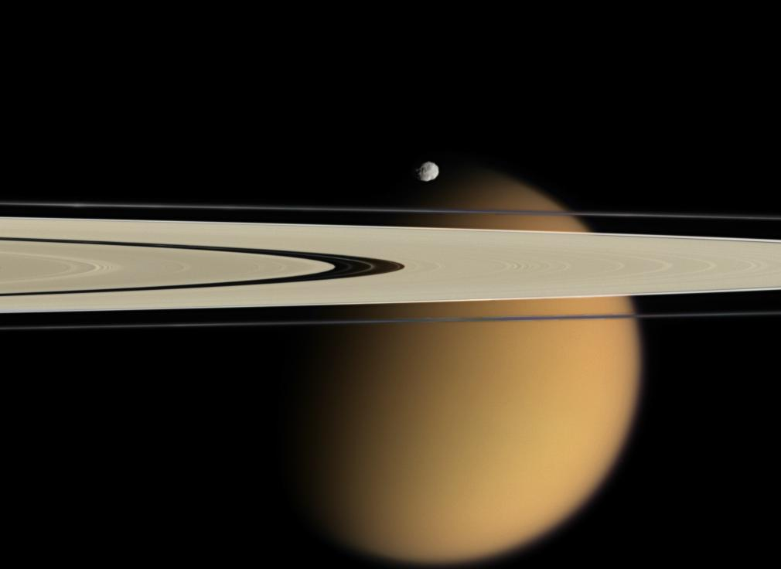






Temperature Variability in Titan’s Upper Atmosphere:
The Role of Wave Dissipation
Lecturer: Xing Wang^{1,2}
Supervisors: Prof. Jun Cui^{1,4,5} and Dr. Yuan Lian³
May 27, 2019 Xining, Qinghai
✉wangxing@nao.cas.cn
¹Key Laboratory of Lunar and Deep Space Exploration, National Astronomical Observatories, Chinese Academy of Sciences, Beijing 100101, People’s Republic of China
²School of Astronomy and Space Science, University of Chinese Academy of Sciences, Beijing 100049, People’s Republic of China
³Aeolis Research, Pasadena, California 91107, United States of America
⁴School of Atmospheric Sciences, Sun Yat-sen University, Zhuhai, Guangdong 519082, People’s Republic of China
⁵Chinese Academy of Sciences Center for Excellence in Comparative Planetology, Hefei, Anhui 230026, People’s Republic of China

Slide 2
Outline
☛ Introduction
☛ Linear Gravity Wave Model
☛ Results
☛ Conclusions
☛ References

Slide 3
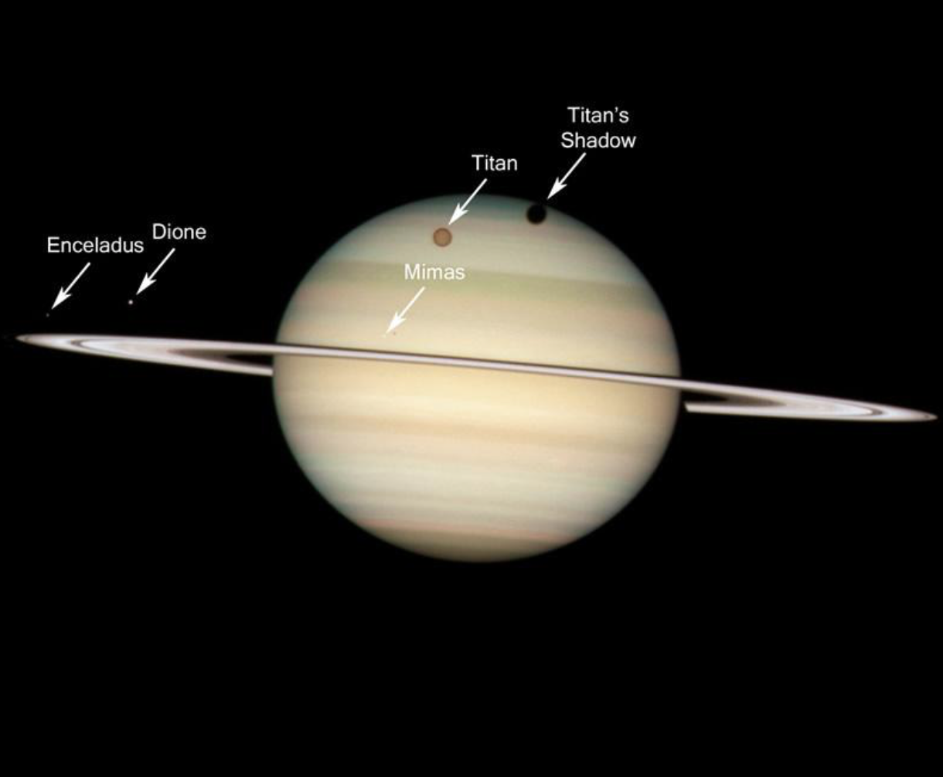
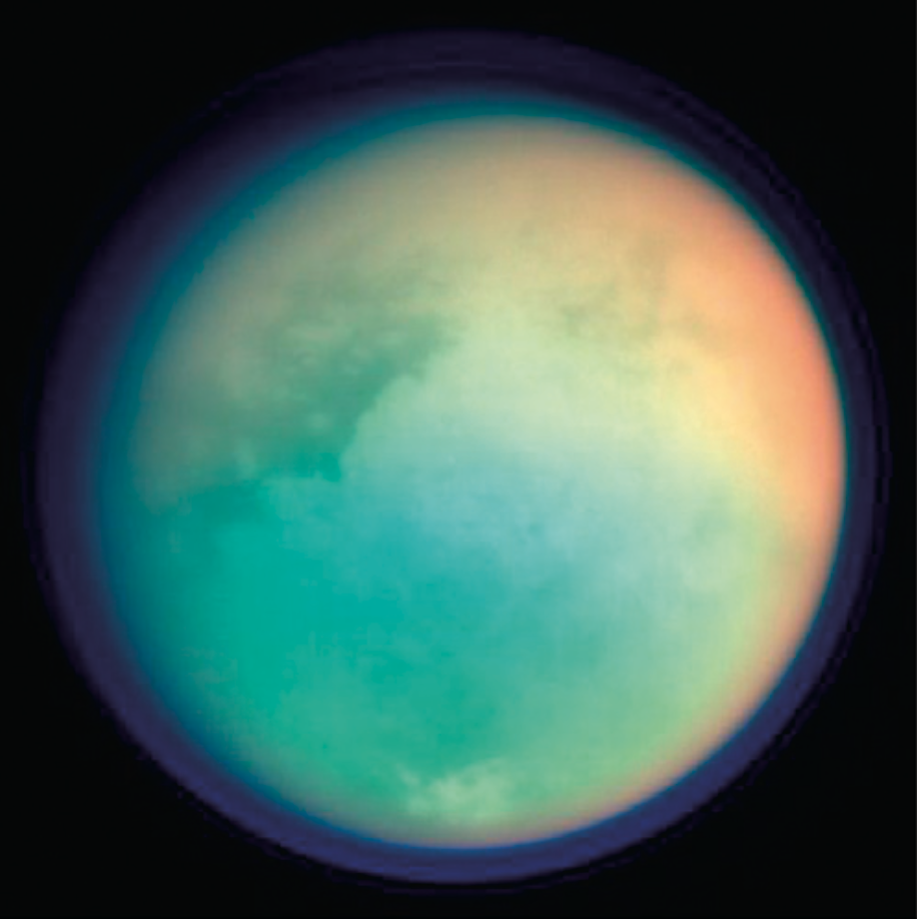
Saturnian System
The largest satellite of Saturn, has a thick and permanent atmosphere that is mainly composed of N₂, CH₄, H₂, and a variety of hydrocarbons and nitriles.

Slide 4
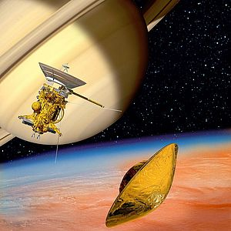
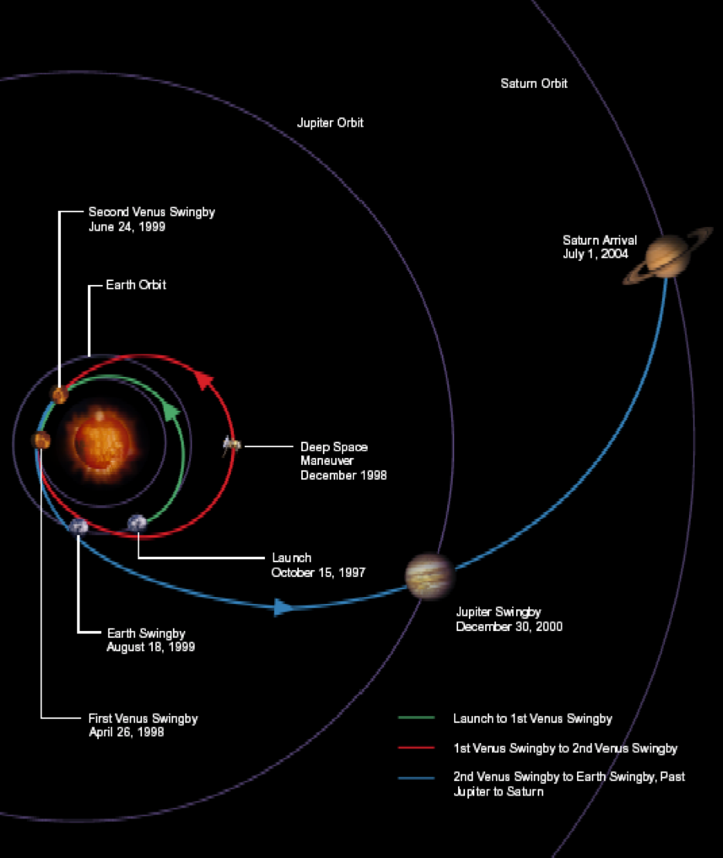
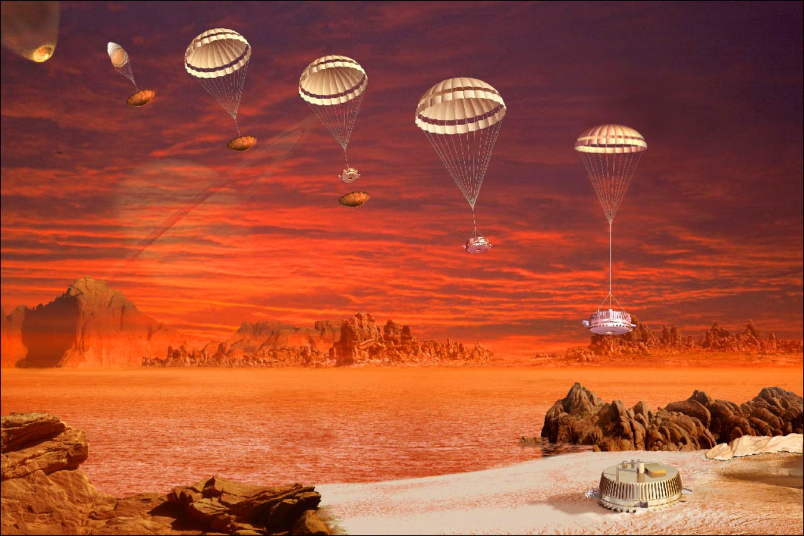
Cassini-Huygens
Cassini Interplanetary Trajectory
Entry, descent, and landing of Huygens (Jan. 14, 2005)

Slide 5
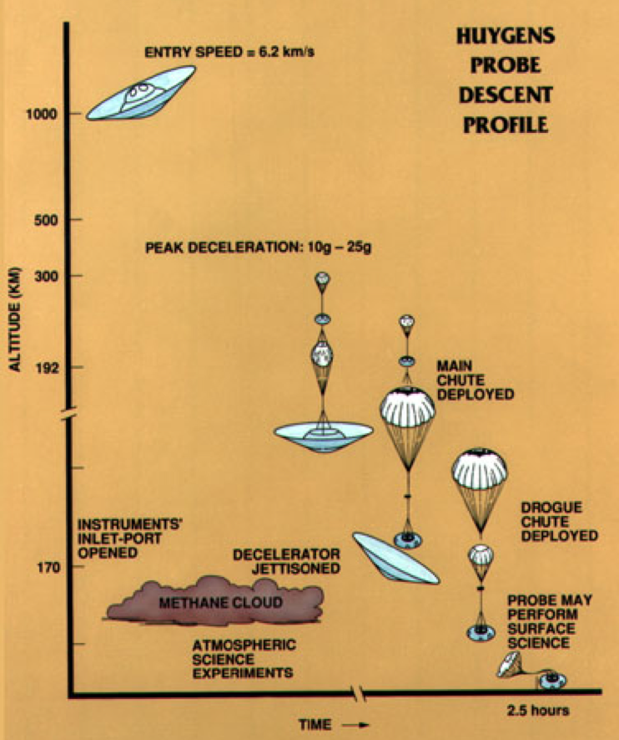
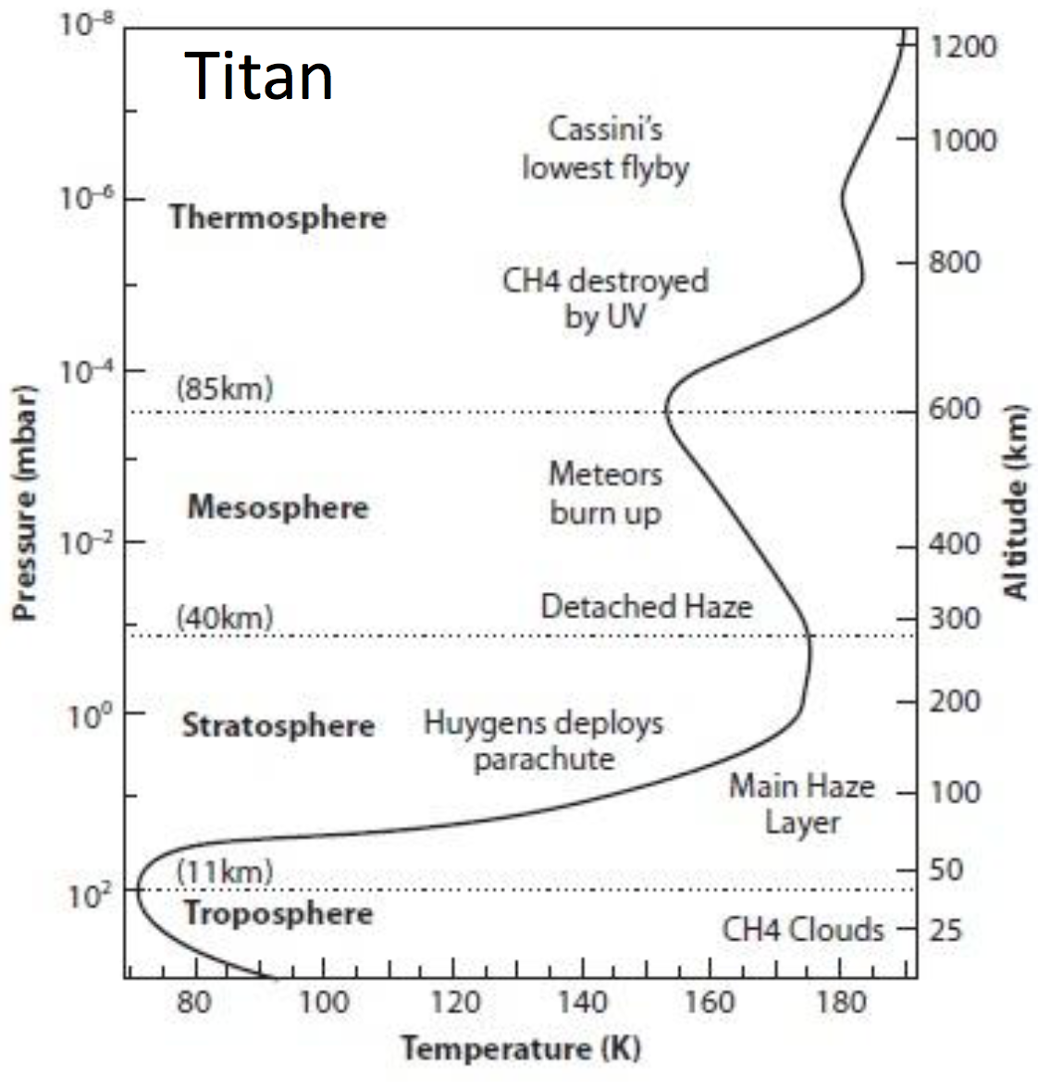
The Atmospheric Structures of Titan

Slide 6
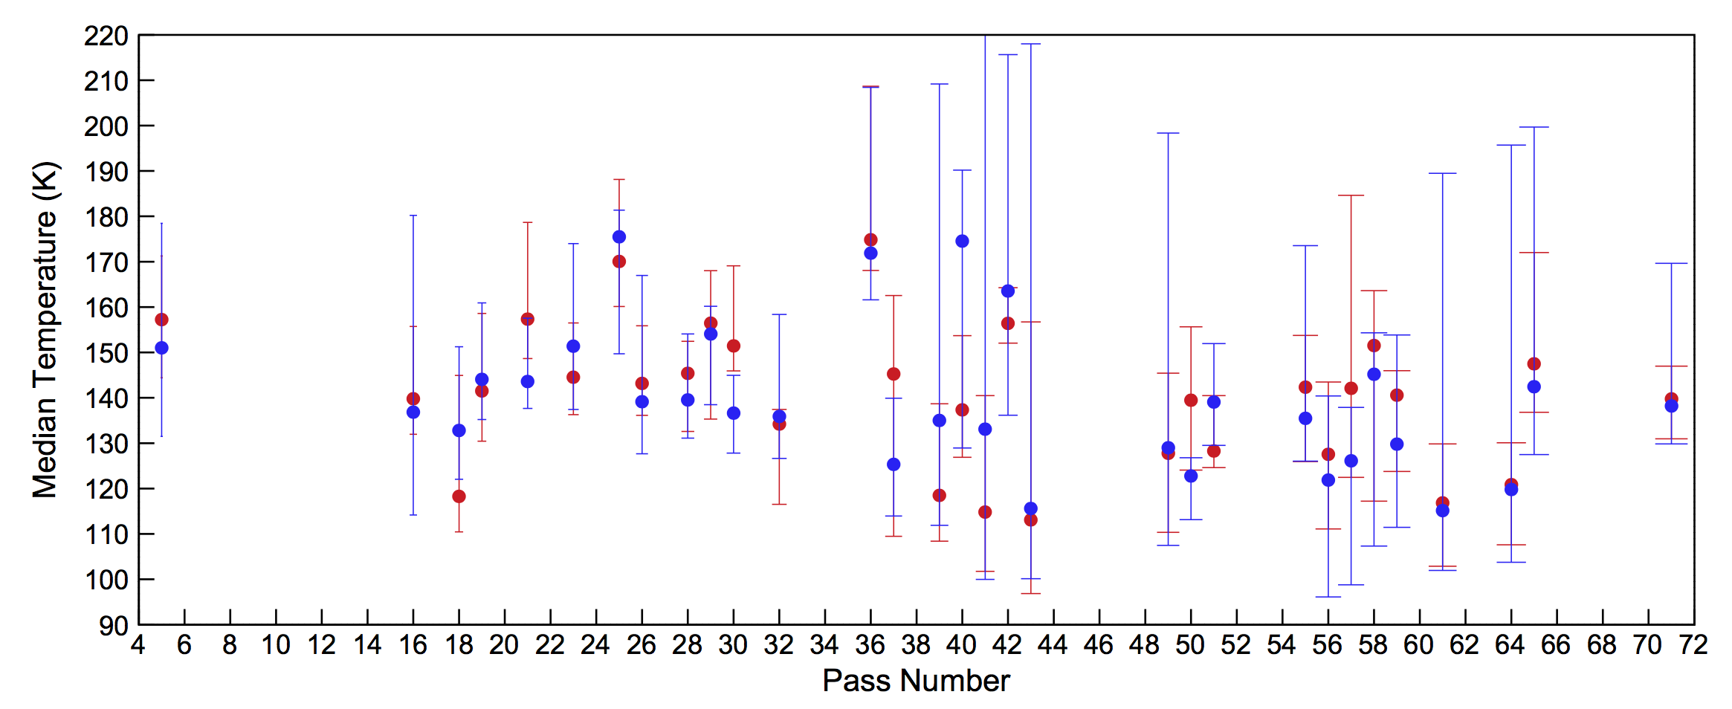
Energy Crisis
Temperature variability over the range of 112-175K among 32 flybys
Snowden, D., Yelle, R.V.,et al. 2013c
☛For this energy crisis phenomenon, there are some scenarios to explain:
Solar EUV radiation, charged particle precipitation, Joule Heating, HCN rotational line emission, wave dissipation.
☛The energy crisis is known to be present in upper atmosphere of four outer giant planets.

Slide 7
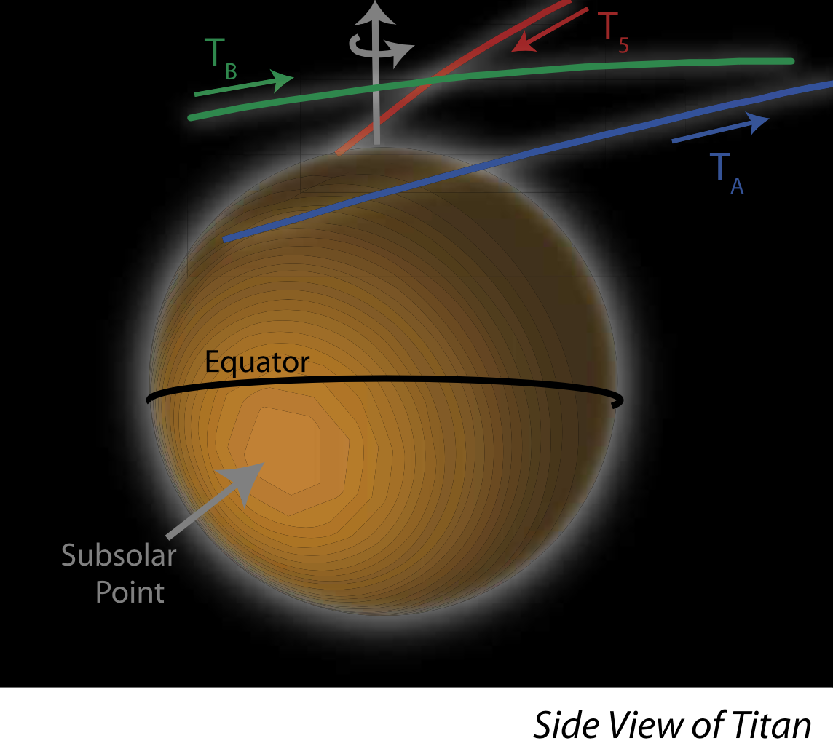
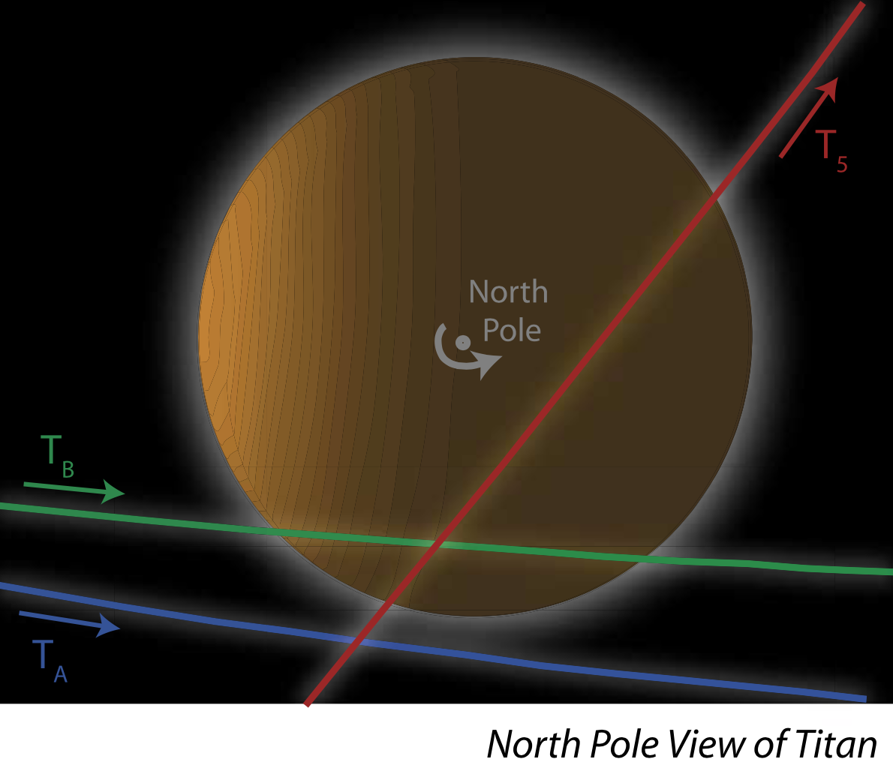
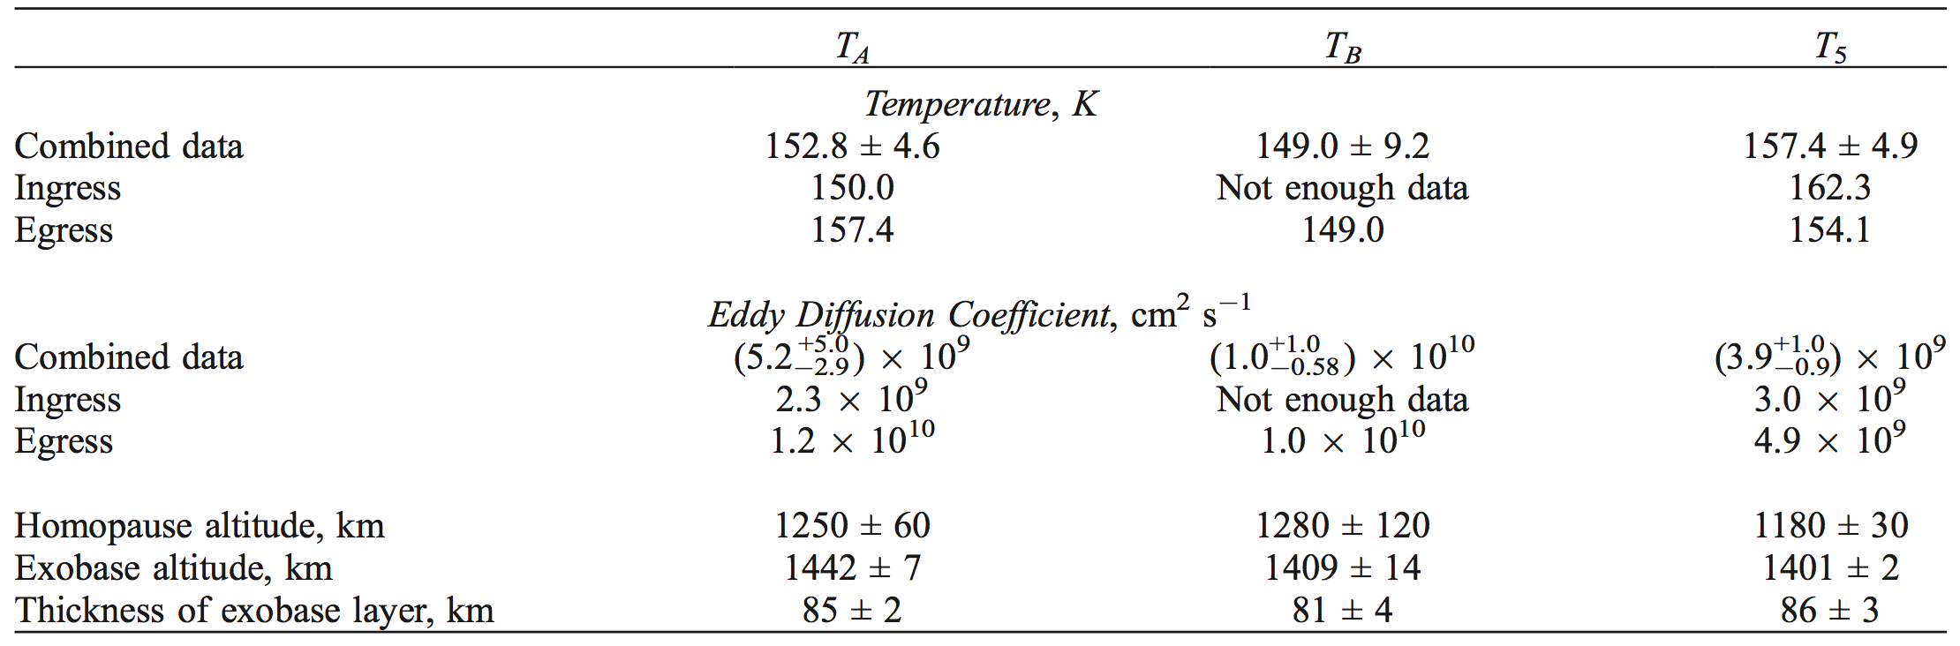
Solar EUV Radiation
Three flybys: T_{A}(Oct.26,2004), T_{B}(Dec. 13,2004), T₅(Apr. 16, 2005)
The dayside temperature was lower than the nightside temperature!
de La Haye, Waite, Johnson et al.2007

Slide 8
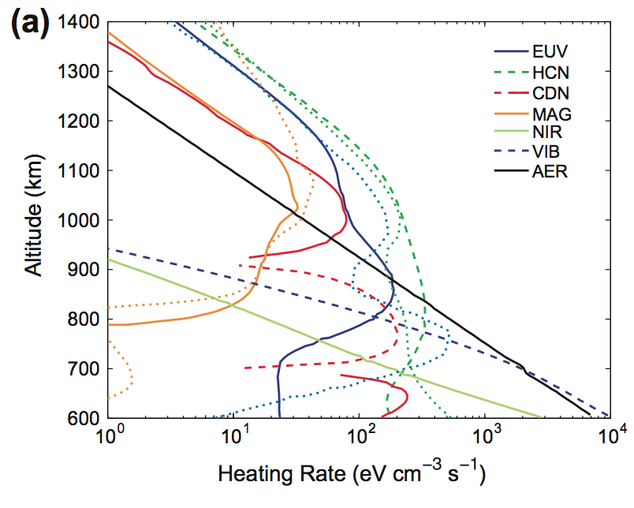
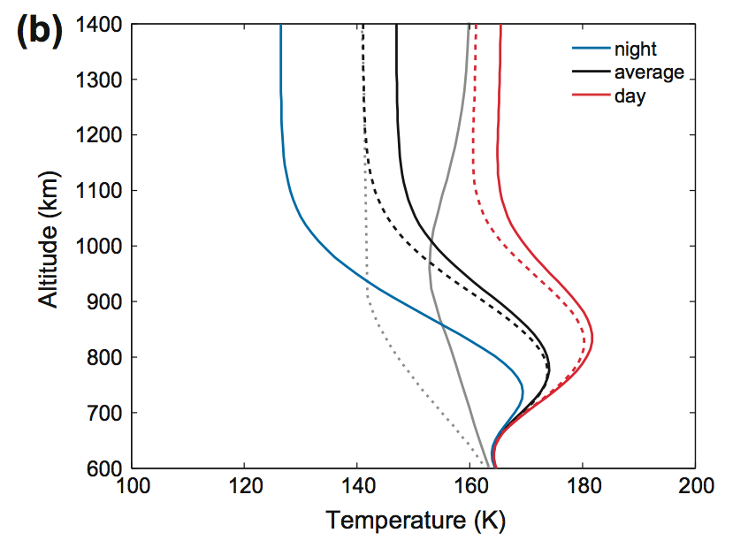
Charged Particle Precipitation from Saturn’s Magnetosphere
At the exobase(1400km), the diurnally averaged temperature with and without magnetospheric heating is 141 and 147 K, the average dayside temperature is 161 and 168 K.
It only results in a ~7K increase in temperature above 1000km altitude!
Snowden, Yelle et al. 2014

Slide 9
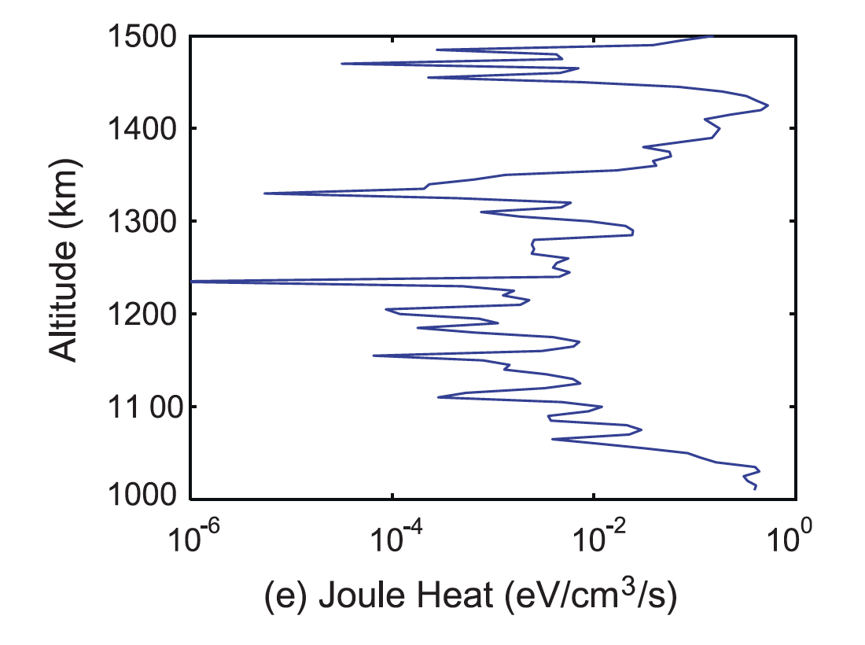
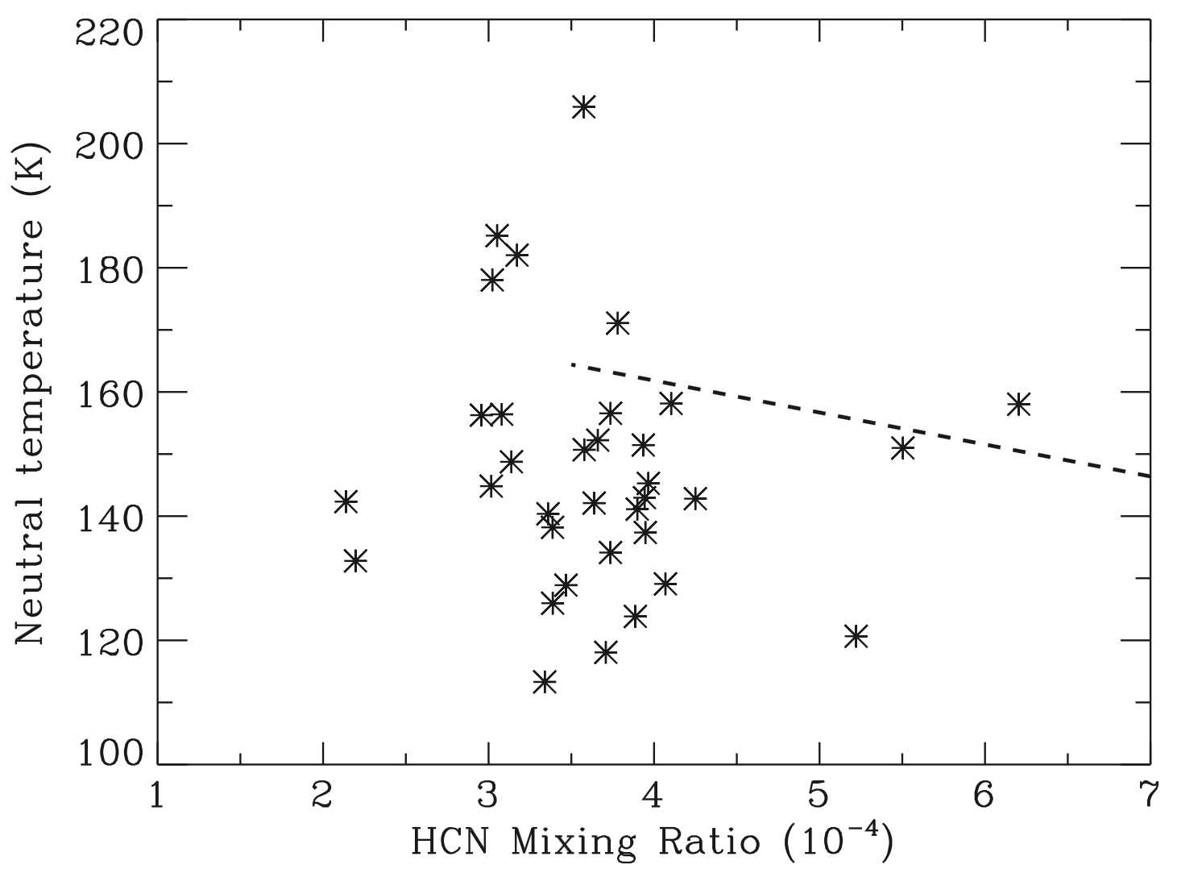
Joule Heating and HCN Rotational Line Emission
The Joule heating rate is less than 1 eV cm⁻³ s⁻¹ at all altitudes, and is insufficient to account for the observed temperature variability!
It indicate that a decrease in HCN volume mixing ratio about twice leads to an increase in temperature from 145 to 165 K above 1200km.
Snowden&Yelle et al. 2014
Cui, Cao, Lavvas et al. 2016

Slide 10
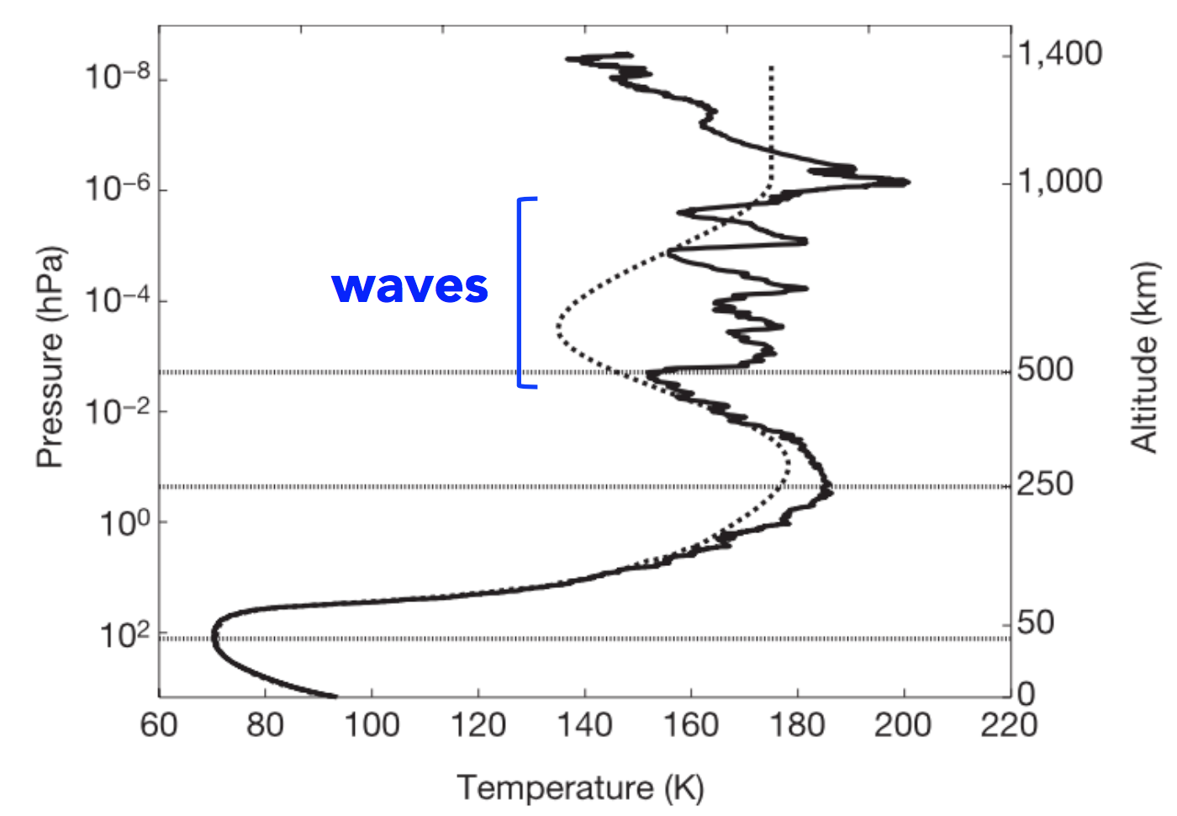
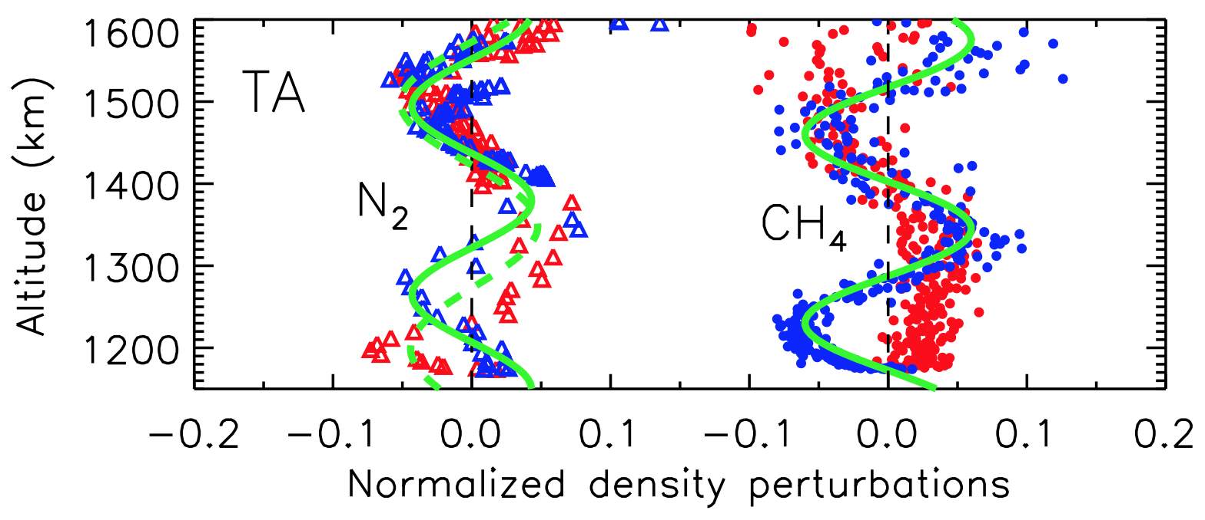
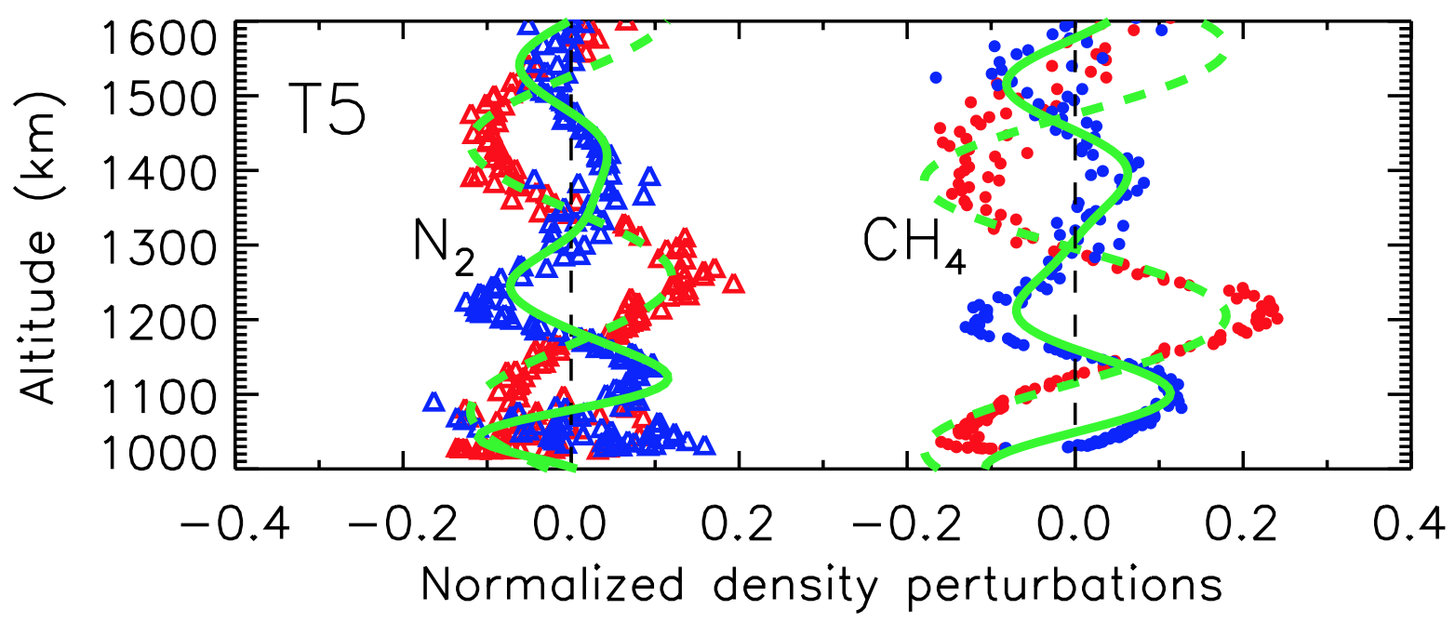
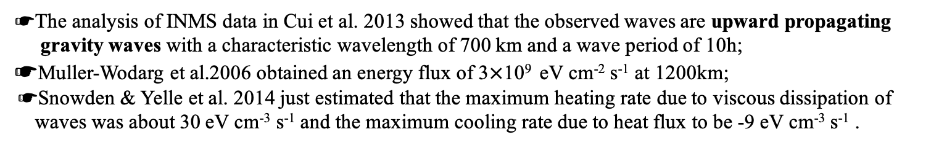
Wave Dissipation
Wave structures were revealed by the Huygens Atmosphere Structure Instrument (HASI) data;
Typical density perturbations of 10% in the upper atmosphere were inferred from the INMS measurements of N₂ and CH₄;
Fulchignoni et al. 2005
Muller-Wodarg et al.2006
☛The analysis of INMS data in Cui et al. 2013 showed that the observed waves are upward propagating
gravity waves with a characteristic wavelength of 700 km and a wave period of 10h;
☛Muller-Wodarg et al.2006 obtained an energy flux of 3$×$10⁹ eV cm⁻² s⁻¹ at 1200km;
☛Snowden & Yelle et al. 2014 just estimated that the maximum heating rate due to viscous dissipation of
waves was about 30 eV cm⁻³ s⁻¹ and the maximum cooling rate due to heat flux to be -9 eV cm⁻³ s⁻¹ .

Slide 11
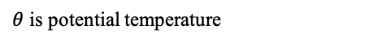
Linear Gravity Wave Model
Model Description:
☛We opt to use anelastic approximation since it can filter out acoustic waves that have not been observed
in Titan’s atmosphere.
☛We assume that:
1.The background atmosphere is plane-parallel and hydrostatically balanced;
2.The background wind is zero or constant;
3.Coriolis effect can be ignored;
☛The resulting system of wave equations are:
Mass Continuity Equation
Neglect!
N-S equation
$θ$ is potential temperature
Equation of state

Slide 12
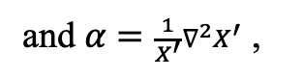
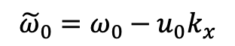
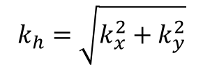
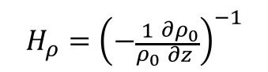
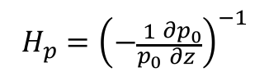
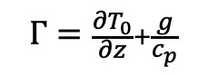
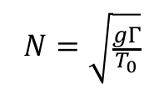
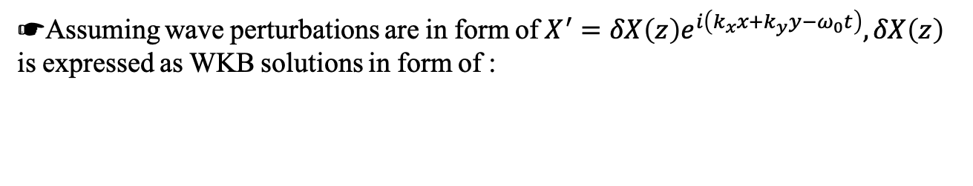
☛Assuming wave perturbations are in form of $X^{′}=δX\left(z\right)e^{i\left(k_{x}x+k_{y}y−ω_{0}t\right)},δX\left(z\right)$ is expressed as WKB solutions in form of :
☛Then, we can get:
This term is neglected due to slow varying background temperature and anelastic approximation!
☛However, according to the above wave equations, we can get:
☛We can obtain the dispersion relation as
☛Where
$${\tilde{ω}}_{0}=ω_{0}−u_{0}k_{x}$$
is the intrinsic wave
and $α=\frac{1}{X^{′}}∇^{2}X^{′}$ ,
frequency.
$$k_{h}=\sqrt{k_{x}^{2}+k_{y}^{2}}$$
is the horizontal wavenumber.
$$H_{ρ}={\left(−\frac{1}{ρ_{0}}\frac{∂ρ_{0}}{∂z}\right)}^{−1}$$
and
$$H_{p}={\left(−\frac{1}{p_{0}}\frac{∂p_{0}}{∂z}\right)}^{−1}$$
are the density and pressure scale height.
$$Γ=\frac{∂T_{0}}{∂z}+\frac{g}{c_{p}}$$
is the atmos-
$$N=\sqrt{\frac{gΓ}{T_{0}}}$$
phere static stability.
is the Brunt-Vaisala frequency.

Slide 13
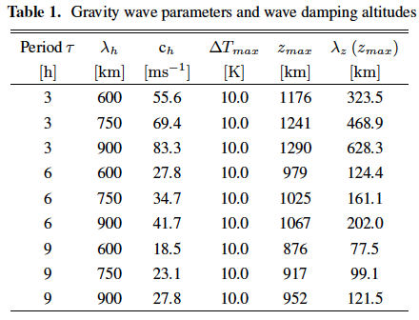
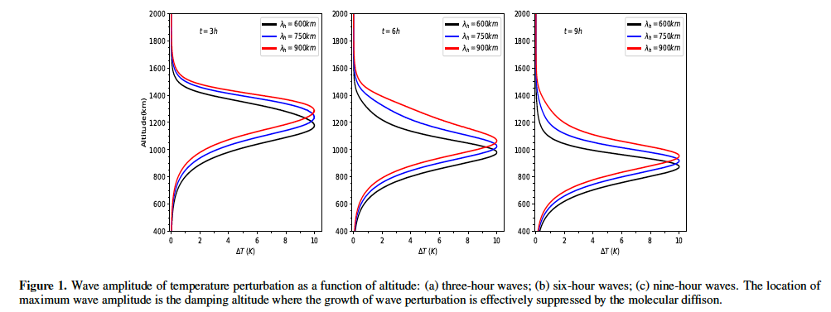

☛Polarization relations:
☛ $τ$ ranged from ~80 min to 10h.(Cui. et al.2013)
These two waves satisify the observed vertical wavelengths range of 170km-360km (Muller-Wodarg et al.2006)
$∆T$ is fixed at 10K (Muller-Wodarg et al.2006)

Slide 14
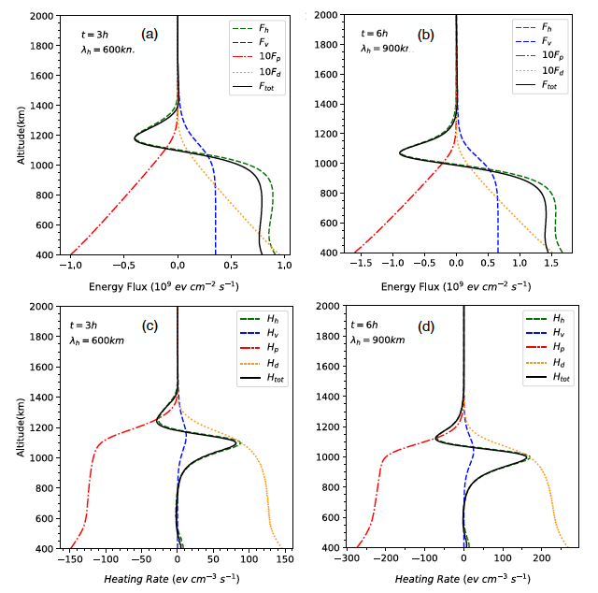
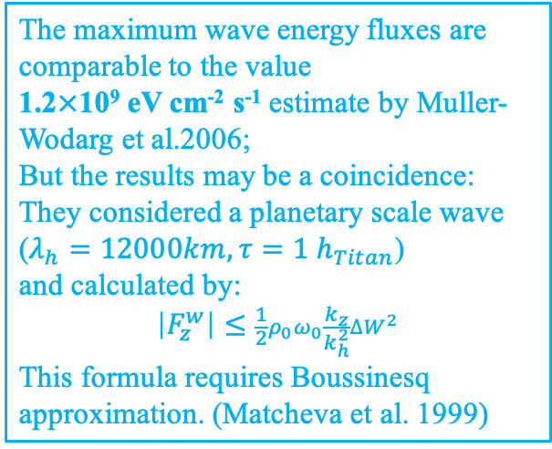
Wave Heating and Cooling
The maximum wave energy fluxes are comparable to the value
1.2$×$10⁹ eV cm⁻² s⁻¹ estimate by Muller-Wodarg et al.2006;
But the results may be a coincidence:
They considered a planetary scale wave ($λ_{h}=12000km, τ=1 h_{Titan}$)
and calculated by:
$$\left|F_{z}^{w}\right|≤\frac{1}{2}ρ_{0}ω_{0}\frac{k_{z}}{k_{h}^{2}}{∆W}^{2}$$
This formula requires Boussinesq approximation. (Matcheva et al. 1999)
☛The total wave heating / cooling rates (Hickey et al. 2000 and Schubert et al. 2003):
is the sensible heat flux;
is the energy flux
associated with viscous dissipation;
is the work done per
unit time by the wave-induced pressure
gradients;
MHR: 80 eV cm⁻³ s⁻¹ MCR: -30 eV cm⁻³ s⁻¹
MHR:160 eV cm⁻³ s⁻¹ MCR:-70 eV cm⁻³ s⁻¹
is the work done per
unit time by the wave-induced Eulerian
drift.
MHR/MCR of these two waves much larger than 30 eV cm⁻³ s⁻¹ and -9 eV cm⁻³ s⁻¹ estimated by Snowden & Yelle et al.2014

Slide 15
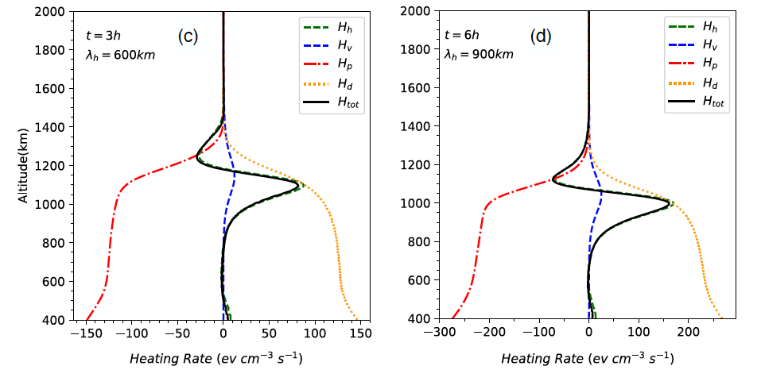
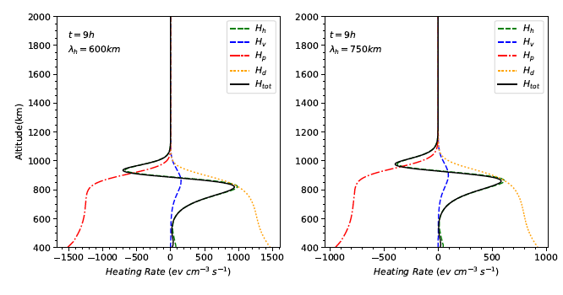
Discussion
Compare Wave Heating/Cooling Rate to Solar EUV Energy Deposition Rate
Solar EUV heating (25%)/ MHR of wave:
75 eV cm⁻³ s⁻¹ / 80 eV cm⁻³ s⁻¹ (1100km)
50 eV cm⁻³ s⁻¹ /160 eV cm⁻³ s⁻¹ (1000km)
Solar EUV heating peak value(25%):
700 eV cm⁻³ s⁻¹ (740-870km)
Heating rate of wave 9h600km,9h750km
400-1000 eV cm⁻³ s⁻¹ (800-900km)

Slide 16
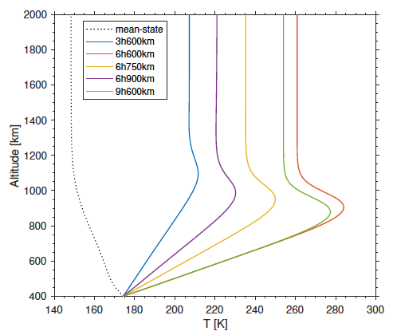
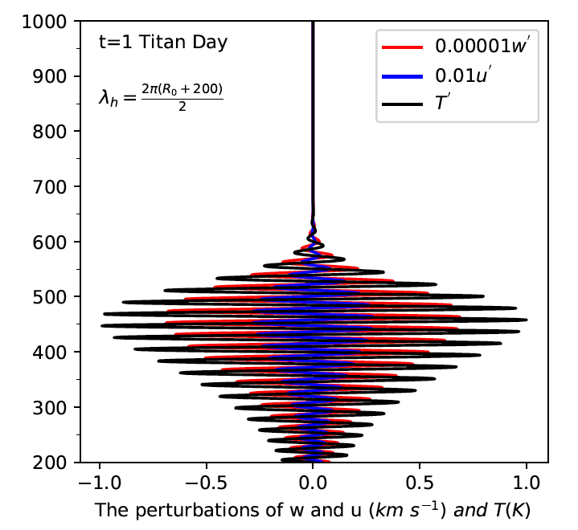
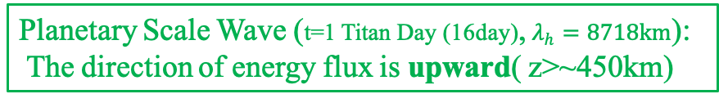
The variability of thermal structure by wave heating/cooling
Temperature variation by waves close to the observed 60K. However, the negative gradient of the mean-state temperature requires downward energy flux to maintain!
~55K
Planetary Scale Wave (t=1 Titan Day (16day), $λ_{h}=8718km$):
The direction of energy flux is upward( z>~450km)
~44K

Slide 17
Conclusions
☛ Solar EUV radiation, charged particle precipitation, Joule Heating, HCN rotational line emission, none of them contributes to the observed temperature variability;(~60K)
☛ Our calculations of GW’s max heating rate larger than solar EUV heating;
☛ Temperature variation by GW close to the observed 60K, but the directions of energy fluxes are opposite to the gradient of the mean-state temperature;
☛ The Planetary Scale Wave may be conform to it, this needs further research.

Slide 18
References
1.Coustenis, A., Achterberg, R. K., Conrath, B. J., et al. 2007, Icarus, 189, 35
2.Cui, J., Yelle, R. V., Müller-Wodarg, I. C. F., Lavvas, P. P., & Galand, M.2011, Journal of
Geophysical Research (Space Physics), 116, A11324
3.Cui, J., Lian, Y., & Müller-Wodarg, I. C. F. 2013, Geophys. Res. Lett., 40,43
4.Cui, J., Yelle, R. V., Li, T., Snowden, D. S. & Müller-Wodarg, I. C. F.2013, EPSC, 593
5.Cui, J., Yelle, R. V., Li, T., Snowden, D. S., & Müller-Wodarg, I. C. F.2014, JGR 119, 490
6.Cui, J., Cao, Y.-T., Lavvas, P. P., & Koskinen, T. T. 2016, ApJL, 826, L5
7.de La Haye, V., Waite, J. H., Johnson, R. E., et al. 2007, JGR112, A07309
8.de La Haye, V., Waite, J. H., Cravens, T. E., et al. 2008, JGR113, A11314
9.Del Genio, A. D., Straus, J. M., & Schubert, G. 1978, GRL.,5, 265-267.
10. Einaudi, F., & Hines, C. O. 1970, Canadian Journal of Physics, 48,1458-1471
11.Fels, S. B. 1982, Journal of the Atmospheric Sciences, 39, 1141-1152
12.French, R. G., & Gierasch, P. J. 1974, Journal of Atmospheric Sciences, 31,1707
13.Fritts, D. C., Wang, L., & Tolson, R. H. 2006, JGR, 111, A12304
14.Fulchignoni, M., Ferri, F., Angrilli, F., et al. 2005, Nature, 438, 785
15.Harris, I., & Priester, W. 1965, Journal of the Atmospheric Sciences, 22,no. 1, 3-10
16.Hines, C. O. 1974, Geophysical Monograph Series, 18, AGU
17.Hinson, D. P., & Jenkins, J. M. 1995, Icarus, 114, 310
18.Holton, J. R., & Zhu, X. 1984, Journal of the Atmospheric Sciences, 41,2653-2662
19.Koskinen, T. T., Yelle, R. V., Snowden, D. S., et al. 2011, Icarus, 216, 507
20.Hickey, M. P., Walterscheid, R. L., & Schubert, G. 2000, Icarus, 148, 266
21.Hickey, M. p., Walterscheid, R. L., & Schubert, G. 2011, JGR, 116, A12326
22.Lian, Y., & Yelle, R. V. 2019, Icarus, 329, 222-245
23.Lindzen, R. S. 1981, Journal of Geophysical Research, 86, 9707-9714

Slide 19
References
24.Matcheva, K. I., & Strobel, D. F. 1999, Icarus, 140, 328
25.Müller-Wodarg, I. C. F., Yelle, R. V., Borggren, N., & Waite, J. H. 2006,JGR.111, A12315
26.Müller-Wodarg, I. C. F., Yelle, R. V., Cui, J., & Waite, J. H. 2008, JGR, 113, E10005
27.Newman, C. E., Lee, C., Lian, Y., Richardson, M. I., & Toigo, A. D. 2011,Icarus, 213, 636-654
28.Parish, H. F., Schubert, G., Hickey, M. P., & Walterscheid, R. L. 2009,Icarus, 203, 28
29.Schubert, G., Hickey, M. P., Walterscheid, R. L. 2003, Icarus, 163, 398-413
30.Snowden, D., Yelle, R. V., Cui, J., et al. 2013, Icarus, 226, 552
31.Snowden, D., & Yelle, R. V. 2014, Icarus, 228, 64
32.Strobel, D. F. 2006, Icarus, 182, 251
33.Vadas, S. L., & Fritts, D. C. 2005, Journal of Geophysical Research, 110,D15103
34.Waite, J. H., Niemann, H., Yelle, R. V., et al. 2005, Science, 308, 982
35.Waite, J. H., Young, D. T., Cravens, T. E., et al. 2007, Science, 316, 870
36.Walterscheid, R. L. 1981, Geophys. Res. Lett., 8, 1235
37.Westlake, J. H., Bell, J. M., Waite, J. H., Jr., et al. 2011,JGR, 116, A03318
38.Woods, T. N. 2005, Journal of Geophysical Research, 116, A03318
39.Yelle, R. V. 1991, ApJ, 383, 380
40.Young, L. A., Yelle, R. V., Young, R., Seiff, A., & Kirk, D. B. 1997,Science, 276, 108

Slide 20
Thanks for Your Listening!
You can download this documentation by scanning the QR code:

